Slide 1
Synchronization: Theoretical Foundation (Week: 5)

Slide 2
Introduction
A DS is a collection of computers that are spatially separated and do not share a common memory
Processes communicate by exchanging messages over communication channel
Messages are delivered after an arbitrary transmission delay
DS suffers some inherent limitations because of lack of common memory and a system wide common clock
How these limitations can be overcome?

Slide 3
Absence of a Global Clock
There is no system-wide common clock in a DS
Solutions can be:
Either having a global clock common to al the computers, or
Having synchronized clocks, one at each computer
Both of the above solutions are impractical due to following reasons:
If one global clock is provided in the DS:
Two processes will observe a global clock value at different instants due to unpredictable delays
So two processes will falsely perceive two different instants in physical time to be a single instant in physical time
if the clocks of different systems are tried to synchronize:
These clocks can drift from the physical time and the drift rate may vary from clock to clock due to technological limitations
This may also end up with the same result
We cannot have a system of perfectly synchronized clocks

Slide 4
Impact of the absence of global time
Temporal ordering of events is integral to the design and development of DS
E.g.
an OS is responsible for scheduling processes
A basic criterion used in scheduling is the temporal order in which requests to execute processes arrive
Due to the absence of the global time, it is difficult to reason about the temporal order of events in a DS
Hence, algorithms for DS are more difficult to design and debug
Also, the up-to-date state of the system is harder to collect

Slide 5
Absence of shared memory
Due to the lack of shared memory, an up-to-date state of the entire system is not available to any individual process
It is necessary for reasoning about the system’s behavior, debugging and recovery
A process in a DS can obtain a coherent but partial view or a complete but incoherent view of the system
A view is said to be coherent if all the observations of different processes are made at the same physical time
A complete view includes the local views (local states) at all the computers and any messages that are in transit in the DS
A complete view is also referred to as global state

Slide 6
Lamport’s Logical clock
Basic Concepts
Lamport proposed the following scheme to order events in a distributed system using logical clocks.
The execution of processes is characterized by a sequence of events
Depending on the application, the execution of a procedure could be one event or the execution of an instruction could be one event
When processes exchange messages, sending a message constitutes one event and receiving a message constitutes one event.

Slide 7
Lamport’s logical clock… Happened before relationship
Due to the absence of perfectly synchronized clocks and global time in distributed systems, the order in which two events occur at two different computers cannot be determined based on the local time at which they occur
under certain conditions, it is possible to ascertain the order in which two events occur based solely on the behavior exhibited by the underlying computation.
The happened before relation(--->) captures the causal dependencies between events, i.e., whether two events are causally related or not. The relation + is defined in the following slide.

Slide 8
Lamport’s logical clock…
a → b, if a and b are events in the same process and a occurred before b.
a → b, if a is the event of sending a message m in a process and b is the event of receipt of the same message rn by another process.
If a → b and b → c , then a → c , i.e., " → " relation is transitive
In distributed systems, processes interact with each other and affect the outcome of events of processes
Being able to ascertain order between events is very important for designing, debugging, and understanding the sequence of execution in distributed computation.

Slide 9
Lamport’s logical clock: Events
In general, an event changes the system state, which in turn influences the occurrence and outcome of future events
past events influence future events and this influence among causally related events (those events that can be ordered by “→ “ ) is referred to as causal affects.

Slide 10
Lamport’s Logical Clock: Events
e₁₁
e₁₂
e₁₃
e₁₄
P₁
Space
e₂₁
e₂₂
e₂₃
e₂₄
P₂
Global time

Slide 11
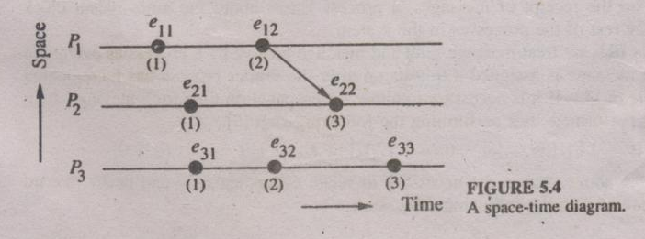
Limitation of Lamport’s clock example 5.4

Slide 12
Vector clock
The system of vector clocks was independently proposed by Fidge and Mattern:
Let n be the number of processes in a distributed system
Each process Pi is equipped with a clock Ci(a), which is an integer vector of length n
The clock Ci can be thought of as a function that assigns a vector Ci(a) to any event a
Ci(a) is referred to as the timestamp of event e1 at Pi. Ci[I] the ith entry of Ci, corresponds to Pi's own logical time
Ci[j] is Pi's best guess of the logical time at Pj. More specifically, at any point in time, the jth entry of Ci indicates the time of occurrence of the last event at Pj which "happened before" the current point in time at Pi
This "happened before" relationship could be established directly by communication from Pj to Pi or indirectly through communication with other processes.

Slide 13
Vector clock…
The figure illustrates an example of how clocks advance and the dissemination of time occurs in a system using vector clocks (d is assumed to be 1 and all clock values are initially zero)
Thus, the system of vector clocks allows us to order events and decide whether two events are causally related or not by simply looking at the timestamps of the events
If we know the processes where the events occur, the above test can be further simplified

Slide 14
Vector clock event example
(1,0,0)
(2,0,0)
(3,4,1)
P₁
e₁₁
e₁₂
e₁₃
(0,1,0)
(2,2,0)
(2,3,1)
(2,4,1)
Space
P₂
e₂₁
e₂₂
e₂₃
e₂₄
(0,0,1)
(0,0,2)
P₃
e₃₁
e₃₂
Global time

Slide 15
Chandy-Lamport’s Global State Recording Algorithm basics
Note: The same algorithm with its example is given on page no.595 of the book by William Stalling
Chandy and Lamport were the first to propose distributed algorithm, which capture a consistent global state (combined state of all processes).
Algorithm assumes that messages are delivered in the order that they are sent and no messages are lost.
The algorithm uses a marker (a special control message) to initiate the algorithm.
The communication channel are assumed to be FIFO.
The recorded global state is also referred as a snapshot (record of all messages sent and received on all channels since the last snapshot) of the system state (sequence of messages that have been sent and received).

Slide 16
Chandy-Lamport’s Global State Recording Algorithm…
Algorithm
Marker sending rule for a process P
P record its state
For each outgoing channel C from P on which a marker has not been already sent,
P sends a marker along C before P sends further messages along C
Marker receiving rule for a process Q
On receipt of a marker along a channel C:

Slide 17
Chandy-Lamport’s Global State Recording Algorithm …
If Q has not recorded its state
Then
Begin
Record the state of C as an empty sequence
Follow the “marker sending rule”
End
Else
Record the state of C as the sequence of messages received
Along C after Q’s state was recorded and before Q received the marker along C

Slide 18
Synchronization: Distributed Mutual Exclusion
(Week:6)

Slide 19
Introduction
In the problem of mutual exclusion, concurrent access to a shared resource by several uncoordinated user-requests is serialized to secure the integrity of the shared resource
It requires that the actions performed by a user on a shared resource must be atomic.
For correctness, it is necessary that the shared resource be accessed by a single site (or process) at a time.
Mutual exclusion is a fundamental issue in the design of distributed systems and an efficient and robust technique for mutual exclusion is essential to the viable design of distributed systems.

Slide 20
Mutual exclusion in single-computer vs. distributed systems
In a single computer system, the status of a shared resource and the status of users is readily available in the shared memory, and the solutions to the mutual exclusion problem can be easily implemented using shared variable(e.g. semaphores)
In DS both shared resources and the users may be distributed and shared memory does not exist.
Consequently, approaches based on shared variable are not applicable to DS and approaches based on message passing must be used.
The problem of mutual exclusion becomes much more complex in DS because of the lack of both shared memory & a common physical clock &because of unpredictable message delays.

Slide 21
Classification of DME Algorithms
Mutual exclusion algorithms can be grouped into two classes.
The algorithms in the first class are nontoken-based
These algorithms require two or more successive rounds of message exchanges among the sites
These algorithms are assertion based because a site can enter its critical section (CS) when an assertion defined on its local variables becomes true
Mutual exclusion is enforced because the assertion becomes true only at one site at any given time.
The algorithms in the second class are token-based
In these algorithms, a unique token (also known as the PRIVILEGE message) is shared among the sites
A site is allowed to enter its CS if it possesses the token and it continues to hold the token until the execution of the CS is over
These algorithms essentially differ in the way a site carries out the search for the token.

Slide 22
System Model
At any instant, a site may have several request for CS.A site queues up these requests and serves them one at a time. A site can be in one of the following three states.
Requesting CS, executing CS, or neither requesting nor executing CS(i.e., idle).
In requesting CS state, the site is blocked and cannot make further request for CS.
In the idle state, the site is executing outside its CS.
In the token-based algorithms, a site can also be in a state where a site holding the token is executing outside the CS.
Such a state is referred to as an idle token state.

Slide 23
Requirement of mutual exclusion
Freedom from Deadlock:
Two or more sites should not endlessly wait for messages that will never arrive.
Freedom from Starvation:
A site should not be forced to wait indefinitely to execute CS while other sites are repeatedly executing CS. that is, every requesting site should get an opportunity to execute CS in a finite time.
Fairness:
Fairness dictates that requests must be executed in the order they are made(or the order in which they arrive in the system).
Fairness implies freedom from starvation.
Fault Tolerance:
A mutual exclusion algorithm is fault-tolerate if in the wake of a failure, it can reorganize itself so that it continues to function without any (prolonged) disruptions.

Slide 24
Performance of DME
The performance of mutual exclusion algorithms is generally measured by the following four metrics:
The number of messages necessary per CS invocation
The synchronization delay, which is the time required after a site leaves the CS and before the next site enters the CS
The response time, which is the time interval a request waits for its CS execution to be over after its request messages have been sent out
The system throughput, which is the rate at which the system executes requests for the CS.
system throughput = 1/ (sd + E)
where sd is the synchronization delay and E is the average critical section execution time

Slide 25
Performance
Low and high load performance
Under low load, there is seldom more than one request for mutual exclusion simultaneously in the system.
Under high load there is always a pending request for mutual exclusion at site. A site is seldom in an idle state under high load conditions.
Best and worst case performance
Performance attains the best possible value.
For example the best value of the response time is the round trip message delay plus CS execution time, 2T+E (where “T” is the average message delay and “E” is the average critical section execution time).
Worst performance occurs under heavy load.

Slide 26
Performance of DME
CS Request Its Request The site enters The site exits
Arrives message sent out the CS the CS
CS execution time
Response Time

Slide 27
A Simple Solution
In a simple solution to distributed mutual exclusion, a site, called the control site, is assigned the task of granting permission for the CS execution
To request the CS, a site sends a REQUEST message to the control site
The control site queues up the requests for the CS and grants them permission, one by one
This method to achieve mutual exclusion in distributed systems requires only three messages per CS execution
This naive, centralized solution has several drawbacks.
First, there is a single point of failure, the control site.
Second, the control site is likely to be swamped with extra work. Also, the communication links near the control site are likely to be congested and become a bottleneck.
Third, the synchronization delay of this algorithm is 2T because a site should first release permission to the control site and then the control site should grant permission to the next site to execute the CS
Throughput = 1 / 2T + E

Slide 28
NON-TOKEN-BASED ALGORITHMS
A site communicates with a set of other sites to arbitrate who should execute the CS next.
For a site Si, request set Ri contains ids of all those sites from which site Si must acquire permission before entering the CS.
Non-token-based mutual exclusion algorithm use timestamps to order requests for CS and to resolve conflicts between simultaneous requests for the CS.
Each request for the CS gets a timestamp, and smaller timestamp requests have priority over larger timestamp requests.

Slide 29
Lamport’s Algorithm basics
Lamport proposed DME algorithm which was based on his clock synchronization scheme
In Lamport messages to be delivered in the FIFO order between every pair of sites
Every site S_{i} keeps a queue, request_ queue, which contains mutual exclusion requests ordered by their timestamps.
Note: The algorithm is on next slide and its example 6.1 is on page126 of the text book.

Slide 30
Requesting the CS
When a site S_{i} wants to enter the CS, it sends a REQUEST(ts_{i},i) message to all the sites in its request set R_{i} and places the request on request_queue_{i,} ((ts_{i}, i) is the timestamp of the request.)
When a site Sj receives the REQUEST (tsi,i) message from site Si, it returns a timestamped REPLY message to Si and places site Si’s request on request_queuej
Executing the CS
Site Si enters the CS when the two following conditions hold:
L1: Si has received a message with timestamp larger than (tsi, i) from all other sites.
L2: Si’s request is at the top of request queue
Releasing the CS
Site Si, upon exiting the CS, removes its request from the top of its request queue and sends a timestamped RELEASE message to all the sites in its request set
When a site Sj receives a RELEASE message from site Si, it removes Si’s request from its request queue

Slide 31
Correctness
Performance
Requires 3(N-1) messages per CS invocation:
(N-1) REQUEST, (N-1) REPLY, and (N-1) RELEASE messages, Synchronization delay is T
Optimization
Can be optimized to require between 3(N-1) and 2(N-1) messages per CS execution by suppressing REPLY messages in certain cases
E.g. suppose site Sj receives a REQUEST message from site Si after it has sent its own REQUEST messages with timestamp higher than the timestamp of site Si’s request
In this case, site Sj need not send a REPLY message to site Si.

Slide 32
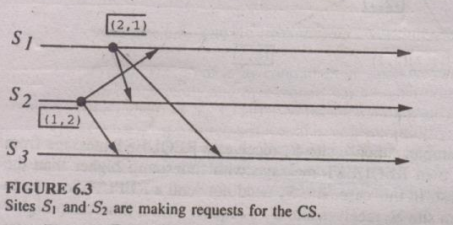
Lamport’s algorithm

Slide 33
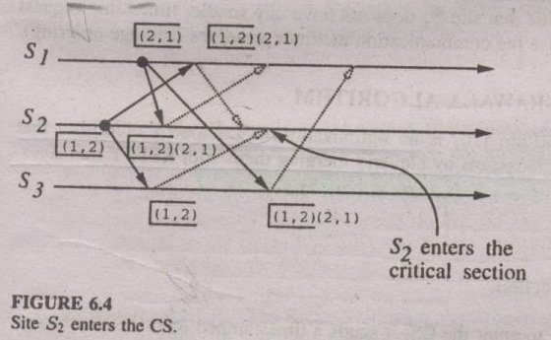
Lamport’s algorithm ….

Slide 34
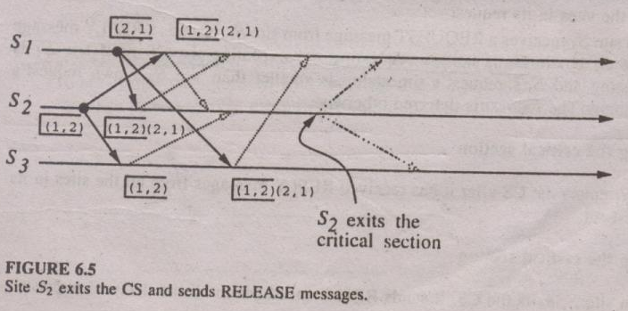
Lamport’s algorithm….

Slide 35
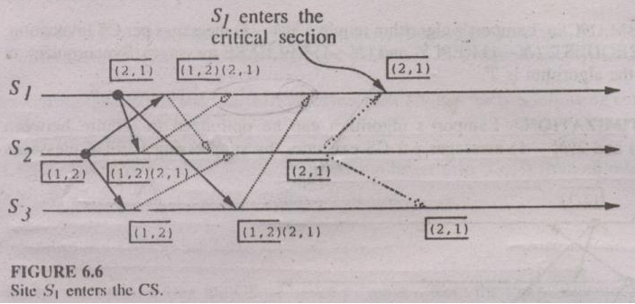
Lamport’s algorithm…

Slide 36
THE RICART-AGRAWALA ALGORITHM basics
Note: The same algorithm is given on page number 605 of William Stalling.
The Ricart Agrawala algorithm is an optimization of Lamport’s algorithm that dispenses with RELEASE messages by cleverly merging them with the REPLY messages.
Algorithm and its example are given on page number 128 and 129 respectively.

Slide 37
THE RICART-AGRAWALA ALGORITHM
The algorithm
Requesting the critical section (CS)
When a site Si wants to enter the CS, it sends the time stamped REQUEST message to all sites
When a site Sj receives a REQUEST message from the site Si, If Sj is currently in its critical section, it defer sending a reply message to site Si
Executing the CS
Site Si enters the CS after it has received REPLY messages from all the sites
Releasing the CS
When the site Si exits the CS, it sends REPLY messages to all the deferred requests.

Slide 38
A generalized Non-token based Algorithm
A generalized non-token-based mutual exclusion algorithm for distributed systems includes all the existing non-token-based mutual exclusion algorithms as special cases.
The concept of information structure forms the basis for unifying different non-token-based mutual exclusion algorithms.
The information structure of a mutual exclusion algorithm defines the data structure needed at a site to record the status of other sites.
The information kept in the information structure is used by a site in making decisions (i.e., from which sites to request permission) when invoking mutual exclusion.
The information structures at a site Si consists of the following three sets:
a request set Ri,
an inform set Ii, and
a status set Sti.
A site also maintains a variable CSSTAT, which indicates the site's knowledge of the status of the CS.

Slide 39
In the generalised algorithm, each request for a CS is assigned a timestamp that is maintained according to Lamport's scheme.
Timestamps are used to priorities requests in case of conflict.
Requesting the critical section.
1. To execute CS, a site sends time stamped REQUEST messages to all the sites in its request set.
2. On the receipt of a REQUEST message, a site Si takes the following actions:
It places the request in its queue (which is ordered by timestamps).
If CSSTAT indicates that the CS is free, then it sends a GRANT message to the site at the top of the queue and removes its entry from the queue.
If the recipient of the GRANT message is in Sti, then CSSTAT is set to indicate that the site is in CS

Slide 40
Executing the critical section.
A site executes the CS only after it has received a GRANT message from all the sites in its request set.
Releasing the critical section.
On exiting the CS, the site sends a RELEASE message to every site in its inform set. On receiving a RELEASE message, a site Si takes the following actions:
CSSTAT is set to free.
If its queue is nonempty, then it sends a GRANT message to the site at the top of the queue and removes its entry from the queue. If the recipient of the GRANT message is in Sti, then CSSTAT is set to indicate that the site is in the CS.
The previous action is repeated until CSSTAT indicates that a site is in the CS or its queue becomes empty

Slide 41
Token based Algorithms
A unique token is shared among all sites.
A site is allowed to enter its CS if it possesses the token
Token based algorithms use sequence number instead of timestamps.
Every request for the token contains a sequence number and sequence number of site advances independently.
A site increments its sequence number every time it makes the request for the token.
A primary function of the sequence number is to distinguish between old and current request.
Second, token based algorithm ensure that mutual exclusion is enforced.

Slide 42
Suzuki-Kasami’s Algorithm basics
Note: the same algorithm is given at page no. 607 of William Stalling
The Suzuki-Kasami's broadcast algorithm is a token-based mutual exclusion algorithm
A unique token is shared among all processes.
If a process possesses the token, it is allowed to enter its critical section
Therefore it broadcasts a request message to all other processes.
The process that possesses the token sends it to the requesting process if the token-owner is not in the critical section.
In that case, the token will be sent after leaving the critical section.
In order to know actual requests, every process keeps an array of integers RNi[1..n], where n is the number of processes, i the ID of process Pi and RNi[j] is the largest sequence number of requests received so far in a request message from process Pj.

Slide 43
The token itself has got an internal FIFO-queue in order to save the requests and an array of integers LN[1..n],
where n is the number of processes and LN[j] is the sequence number of the request that process pj executed most recently.
Thereby it is possible to check, if a process has already been executed
So this array includes the most actual known requests of every process.

Slide 44
Algorithm
Requesting the critical section
If the requesting process does not have the token, it increments its sequence number RNi[i], and sends a REQUEST(I, sn) message to all other sites
When a site Sj receives this message, it sets RNj[i] to max(RNj[i], sn). If Sj has the idle token, then it sends the token to Si if RNj[i]=LN[i]+1
Executing the CS
Site Si executes the CS when it has received the token
Releasing the CS.
Having finished the execution of the CS, site Si takes the following actions:
It sets LN[i] element of the token array equal to RNi[i]
For every site Sj whose ID is not in the token queue, it appends its ID to the token queue if RNi[j]=LN[j]+1
If token queue is nonempty after the above update, then it deletes the top site ID from the queue and sends the token to the site indicated by the ID

Slide 45
RAYMOND’s TREE-BASED ALGORITHM basics
Sites are logically arranged as a directed tree such that the edges of the tree are assigned direction toward the site i.e. root of the tree that has the token
Every site has a local variable holder that points to an immediate neighbor node on a directed path to the root node
Thus holder variables at the sites defines logical tree structure among the sites.
If we follow holder variable at sites, every site has a directed path leading to the site holding the token.
At root site holder points to itself.
Every sites keeps a FIFO queue called request_q, which stores the request of those neighboring sites that have sent a request to this site but have not yet been sent the token.

Slide 46
RAYMONDS TREE-BASED ALGORITHM
Note: The algorithm and its example is given on page no 142 and 144 respectively.
The Algorithm
Requesting the critical section (CS)
When the site wants to enter the CS, it sends a REQUEST message to the node along the directed path to the root.
When a site receives this message, it places the REQUEST in its request_q and sends a REQUEST message along the directed path to the root.
When root receives the REQUEST message, it sends the token to the site from which it received the REQUEST message.
When a site receives the token, it deletes the top entry from its request_q, sends the token to the site indicated in this entry.

Slide 47
RAYMONDS TREE-BASED ALGORITHM ..
Executing the CS
A site enters the CS, when it receives the token
Releasing the CS
After the site has finished execution of the CS it releases the token for the requesting site
Note: Raymond’s algorithm can use greedy strategy, where a site receiving the token executes the CS even though its request is not at the top of its request q. This strategy may not be fair and can cause starvation.

Slide 48
Synchronization: Distributed Deadlock Detection & Algorithms
(WEEK:7)

Slide 49
Introduction
In distributed systems, a process can request and release resources (local or remote) in any order, which may not be known a priori and a process can request some resources while holding others
If the sequence of the allocation of resources to processes is not controlled in such environments, deadlocks can occur.
The problem of deadlocks has been generally studied in distributed systems under the following model:
The systems have only reusable resources.
Processes are allowed only exclusive access to resources.
There is only one copy of each resource.

Slide 50
Deadlock Handling Strategies in DS
The deadlock handling is complicated to implement in DS because no one site has accurate knowledge of current state of the system & because every intersite communication involves a finite and unpredictable delay. There are three strategies to handle deadlock
Deadlock prevention
Deadlock Avoidance
Deadlock Detection

Slide 51
Deadlock Prevention
It is commonly achieved by either having a process acquire all the needed resources simultaneously before it begins execution or by preempting a process that holds the needed resource
The Wait-Die Scheme:
A non-preemptive approach
When process Pi requests a resource currently held by Pj, Pi is allowed to wait only if it has a smaller timestamp than does Pj (Pi is older than Pj)
Otherwise Pi is rolled back
The Wound-Wait scheme:
A preemptive approach
When process Pi requests a resource currently held by Pj, Pi is allowed to wait only if it has a larger timestamp than Pj ( pi is younger)
Otherwise Pj is rolled back (pj is wounded)

Slide 52
Deadlock prevention
It is commonly achieved by either having a process acquire all the needed resources simultaneously before it begins execution or by preempting a process that holds the needed resource
But the difficulty is to acquire resources in advance, because future resource requirements are unpredictable.
However, the solution to this problem is to forcing processes to acquire resources one by one. This solution is inefficient and impractical.

Slide 53
Deadlock Avoidance
A resource is granted to a process if the resulting global state is safe ( a global state includes all the processes and resources of the DS)
Deadlock is practically impossible to implement because
Every site ahs to maintain information on the global state of the system, which translates into huge storage requirements an extensive communication costs
The process of checking for a safe global state must be mutually exclusive, because if several sites concurrently perform checks for a safe state they may all find the state safe but the net global state may not be safe
Due to the large number of processes and resources it will be computationally expensive to check for a safe state

Slide 54
Deadlock Detection
It requires an examination of the status of process-recourse interactions for the presence of cyclical wait.
Deadlock detection in DS has two favorable conditions.
Once a cycle is formed in WFG, it persists until it is detected and broken.
Cycle detection can proceed concurrently with the normal activities of a system( and therefore it does not have a negative effect on system throughput)
The literature on deadlock handling is distributed systems is highly focused towards deadlock detection method.

Slide 55
Issues In Deadlock Detection & Resolution
Deadlock detection and resolution has two basic issues:
Detection of existing deadlocks
Resolution of detected deadlocks
Detection:
The detection of deadlocks involves two Issues:
maintenance of the WFG and
search of the WFG for the presence of cycles (or knots)
In distributed systems, a cycle may involve several sites, so the search for cycles greatly depends upon how the WFG of the system is represented across the system
Depending upon the manner in which WFG information is maintained and the search for cycles is carried out, there are centralized, distributed, and hierarchical algorithms for deadlock detection in distributed systems.

Slide 56
Detection…
A correct deadlock deduction algorithm must satisfy the following two conditions:-
Progress-No undetected deadlocks. The algorithm must detect all existing deadlocks in finite time.
Safety-No false deadlocks. The algorithm should not report deadlocks which are non-existent (called phantom deadlocks)
Deadlock resolution
It involves breaking existing wait-for dependencies in the system WFG to resolve the deadlock
It involves rolling back one or more processes that are deadlocked and assigning their resources to blocked processes in the deadlock so that they can resume execution

Slide 57
Control Organizations for Distributed Deadlock Detection
Centralized Control
Provided with a control site responsible of constructing WFG
However, a single point of failure, congested links, continuous message generation for deadlock detection, are the demerits.
Distributed Control
Detection of a global deadlock is shared equally
Deadlock detection is initiated only when a waiting process is suspected to be a part of deadlock cycle.
However, such systems are difficult to design, several sites may initiate detection for the same deadlock, proof of correctness is difficult, deadlock resolution is cumbersome.
Hierarchical Control
Site detects deadlocks involving only its descendent sites
Exploits access patterns local to a cluster of sites to efficiently detect deadlocks.
However, the control is defeated if most deadlocks span several clusters.

Slide 58
Deadlock resolution
It involves breaking existing wait-for dependencies in the system WFG to resolve the deadlock
It involves rolling back one or more processes that are deadlocked and assigning their resources to blocked processes in the deadlock so that they can resume execution

Slide 59
Distributed deadlock detection algorithms
In distributed deadlock detection algorithms, all sites collectively cooperate to detect a cycle in the state graph that is likely to be distributed over several sites.
This algorithm initiated when a process is forced to wait. It is initiated either by local site or by the site where the process waits.
In path pushing algorithms wait for dependency information of the global WFG is spread in the form of paths.
In the edge chasing algorithm, special messages called probes are circulated along the edges of WFG to detect a cycle.

Slide 60
Distributed deadlock detection algorithms…
A Path-Pushing Algorithm
The site waits for dead-lock related information from other sites. Note that deadlock related information is passed by sites in the form of paths.
The site combines the received information with its local TWF (Transaction wait for graph) graph to build an updated TWF graph. It then detect all cycles and breaks only those cycles which do not contain the node Ex (External node).
Ex helps in detecting multi-site deadlock without requiring a huge global TWF graph.
For all cycles ‘Ex-T1-T2-Ex’ which contain the node Ex (these cycles are potential candidates for global deadlock) , the site transmit them in string form to all other sites
The algorithm message traffic reduces by only sending higher ordering transaction, for e.g. T1 ordering is higher than T2
Also for a deadlock the highest priority transaction detects deadlock

Slide 61
Distributed deadlock detection algorithms…
An-edge chasing algorithm
Uses a special message called probe. A probe is a triplet (i,j,k) denoting that it belongs to a deadlock detection initiated for process Pi and it is being sent by the home site Pj to the home site of process Pk.
A probe message travels along the edges of the global TWF graph and a deadlock is detected when a probe message return to its initiated site.

Slide 62
Distributed deadlock detection algorithms…
An edge-chasing algorithm…
If Pi is locally dependent on itself
Then declare a deadlock
Else for all Pj and Pk such that
Pi is locally dependent upon Pj and
Pj is waiting on Pk and
Pj and Pk are on different sites,
send probe (i,j,k) to the home site of Pk

Slide 63
Distributed deadlock detection algorithms…
On the receipt of probe (i,j,k)
If
Pk is blocked
Dependent_{k} (i) is false, and
Pk has not replied to all request of Pj
Then
begin
dependent_{k} (i)=true
If k=i

Slide 64
Distributed deadlock detection algorithms…
Then declare that Pi is deadlock
Else for all Pm and Pn such that
Pk is locally dependent upon Pm and
Pm is waiting on Pn and
Pm and Pn are on different sites,
Send probe (I,m,n) to home site of Pn
end

Slide 65
Distributed deadlock detection algorithms…
Example 7.1
Consider the system as shown in figure 7.1. If process P1 initiates deadlock detection, it sends probe (1,3,4) to S2. since P6 is waiting for P8 and P7 is waiting for P10, S2 sends probes (1,6,8) and (1,7,10) to S3 which in turn sends probe (1,9,1), S1 declares that P1 is deadlock.

Slide 66
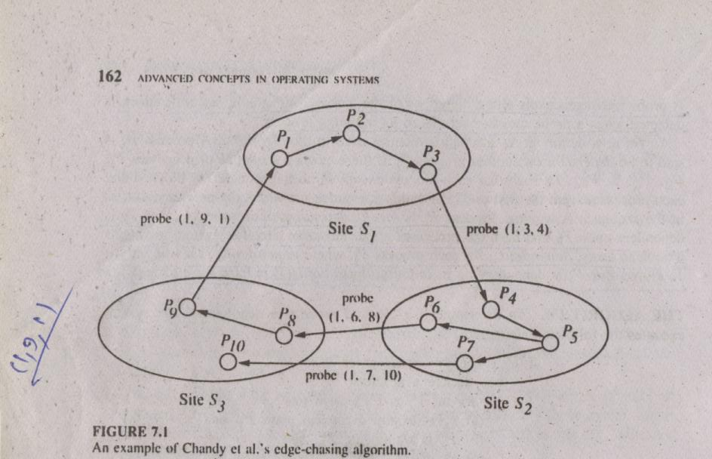
Distributed deadlock detection algorithms… figure 7.1

